Slide 1
Cryptography

Slide 2
Overview
Historical uses of Cryptography
Security Services provided by cryptography
Definitions and terms
Symmetric Cryptography
Asymmetric Cryptography
Hybrid Cryptography
Integrity through Hashing, MACs and Digital Signatures
Public Key Infrastructure
IPSec
Attacks on Cryptography

Slide 3
Cryptography in History
Caesar Machine
Scytale
Vignere
Vernam
Enigma Machine and Purple Machine

Slide 4
Caesar Cipher
Simple Substitution
Shift Characters 3 spaces
A=D, B=E, C=F, etc
Substitution Ciphers are subject to pattern analysis

Slide 5
Scytale
Spartans used this cipher to communicate messages to generals in the field
Wrapped tape around a rod
Diameter of the rod is the pre-agreed upon secret (key)

Slide 6
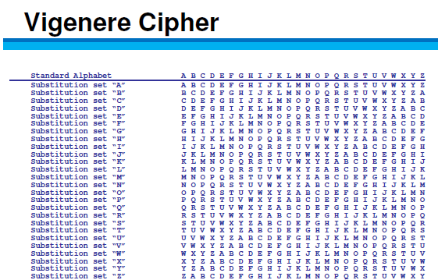
Vignere
First polyalphabetic cipher
Key word is agreed upon ahead of time
First letter of the key is matched up against first letter of the message, and so on

Slide 7
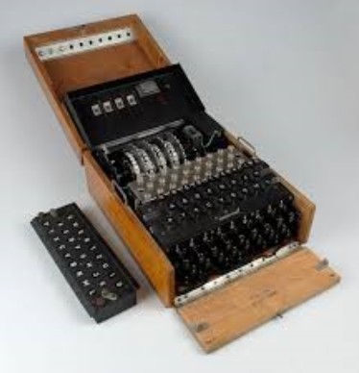
Cryptography in Warfare
Enigma Machine/Purple Machine
Used by the Germans/Japanese in WWII
Breaking the cryptography of these devices is credited with reducing the length of the war.

Slide 8
Vernam Cipher
One Time Pad
Only mathematically unbreakable form of cryptography
Key must be used only once
Pad must be at least as long as the message
Key pad is statistically unpredictable
Key Pad must be delivered and stored securely

Slide 9
Security Services provided by Cryptography
Privacy: Prevents unauthorized disclosure of information
Authenticity: Verifies the claimed identity
Integrity: Detects modification or corruption
Non-Repudiation: Combines authenticity and integrity. A sender can’t dispute having sent a message, nor its contents.

Slide 10
Definitions and Concepts
Plain Text + Initialization Vector + Algorithm + Key
=
Ciphertext

Slide 11
Definitions and Concepts
Plain text is unencrypted text
Initialization Vector (IV) adds randomness to the beginning of the process
Algorithm is the collection of math functions that can be performed
Key: Instruction set on how to use the algorithm

Slide 12
Elements of Cryptography
Desirable Qualities of an Algorithm
Confusion
Diffusion
Avalanche
Permutations
Open—Kerckhoff’s Principle
Desirable Qualities of a Key
Long
Random
Secret

Slide 13
Cryptography
Cryptography
Asymmetric
Symmetric
Stream
Discrete Logarithms
Factorization
Block
Diffie -Hellman
RSA
RC-4
AES/3DES
ECC
El Gamal

Slide 14
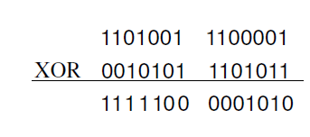
Stream Ciphers XOR

Slide 15
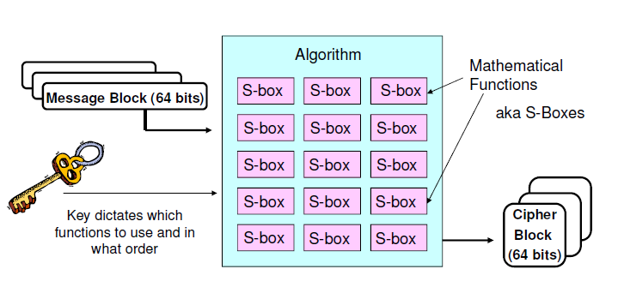
Block Ciphers

Slide 16
Symmetric Cryptography
Symmetric = Same
In symmetric cryptography the same key is used to both encrypt and decrypt
Very fast means of encrypting/decrypting with good strength for privacy
Preferred means of protecting privacy data
Also can be called “Private Key” “Secret Key” or “Shared Key” Cryptography

Slide 17
Stream vs. Block
Stream Ciphers encrypt one bit (up to one byte) of data at a time.
Transposition, Substitution, XOR
Very fast and efficient
Not as Secure
RC-4 is the only stream cipher necessary for the test
Block Ciphers chunk data into blocks. Each chunk goes through a series of math functions called S-boxes

Slide 18
Drawbacks to Symmetric Cryptography
Out of band key exchange
Not Scalable N * (N-1)
²
No Authenticity, Integrity or Non-repudiation

Slide 19
Asymmetric Cryptography
Every user has a key pair.
Public key is made available to anyone who requests it
Private key is only available to that user and must not be disclosed or shared
The keys are mathematically related so that anything encrypted with one key can only be decrypted by the other.

Slide 20
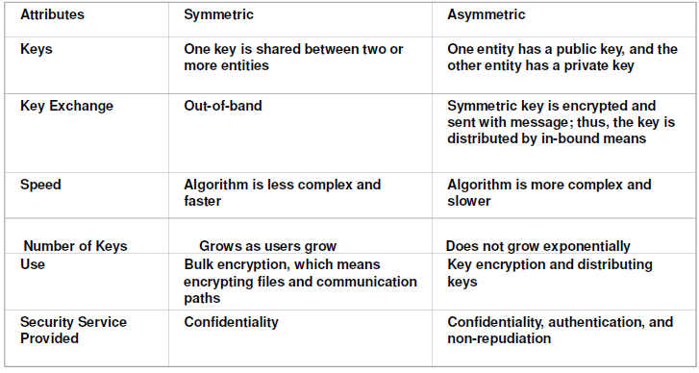
Summary of Symmetric vs. Asymmetric

Slide 21
Common Symmetric Algorithm
DES
3DES
AES
RC-4
RC-5
Two Fish
Blowfish
IDEA
CAST
MARS

Slide 22
5 Modes of DES
ECB (Electronic Code Book): Very weak, but very fast. Same plaintext produces the same cipher text. Used PINs. Hard to detect patterns with such a small amount of data
CBC (Cipher Block Chaining): Output from one function is used as input into the next. (Cascading errors)
**These are the most commonly asked about modes of DES

Slide 23
Modes of DES continued
Remaining 3 modes act like a stream
CFB—terminal services
OFB—satellits
CTR—some wireless devices

Slide 24
4 Modes of 3DES
EEE2
EEE3
EDE2
EDE3

Slide 25
Common Asymmetric Algorithms
DSA
RSA
ECC (Eliptical Curve Cryptography)
El Gamal
Diffie Hellman
Knapsack

Slide 26
RSA
Named for Rivest, Shamir, and Adleman, the creator
Currently the standard for Digital Signatures
Uses the idea that there is no efficient way to factor the product large prime numbers
The math used for RSA is sometimes referred to as a trap-door function
Notes:
Y

Slide 27
Diffie Hellman
The first asymmetric algorithm
Secure key-agreement without pre-shared secrets
Based on discrete logarithms in a finite field

Slide 28
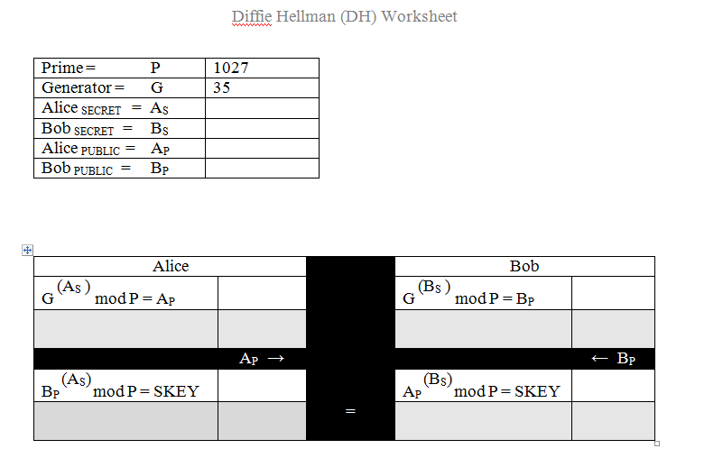
Diffie Hellman Key Agreement

Slide 29
ECC (Eliptical Curve Cryptography)
Based upon plotting points upon a curve
Very efficient, but only designed to work within certain environments
Frequently used for handheld devices due to their limited processing capability

Slide 30
P.A.I.N Services through Asymmetric Cryptography and Hashing
Privacy: Receiver’s Public Key
Authenticity: Sender’s Private Key
Integrity (not asymmetric OR symmetric)
Non-Repudiation: Hash encrypted Sender’s Private Key
Notes:
Privacy: Always encrypt with the receiver’s PUBLIC key. Receiver decrypts with receiver’s PRIVATE key which only that receiver has.
Authenticity: Sender will encrypt “something” with the sender’s PRIVATE key. When the receiver is able to successfully decrypt that “something” with that sender’s PUBLIC key, that proves it was encrypted with the sender’s PRIVATE key, which only the sender has.
Integrity: Create a message digest (hash) with a hashing algorithm (MD5, SHA-1, SHA 256)
Non-Repudiation. Sender encrypts hash with the sender’s private key. Receiver decrypts hash with sender’s public key. Receiver hashes document—if hashes match, receiver gets a guarantee that message has not been modified. This is called a digital signature.

Slide 31
Review Symmetric vs. Asymmetric
Symmetric
Fast
Out of band key exchange
No integrity, authenticity or authenticity
Not Scalable
Asymmetric
Slow
Scales to large organizations well
Provides non-repudiation
Key exchange does not require exchange of any secret information

Slide 32
Hybrid Cryptography in SSL/TLS
Client initiates a secure connection
Server responds by sending it’s public key to the client
The client then generates a symmetric session key.
Client encrypts uses the server’s public key to encrypt the session key.
Client sends the session key (encrypted with the server’s public key) to the server
Server uses it’s private key to decrypt the session key
Now that a symmetric session key has been distributed, both parties have a secure channel across which to communicate.

Slide 33
Integrity
Data gets modified
Accidentally through corruption
Intentionally through malicious alteration
Hash: only good for accidental modification
MAC: Provides reasonable authenticity and integrity not strong enough to be non-repudiation (because it uses a symmetric key)
Digital Signatures: Can detect both malicious and accidental modification, but requires an overhead. Provides true non-repudiation

Slide 34
Hashing
Digital representation of the contents of the file
If the file changes, the hash will change
One way math
When two different documents produce the same hash it is called a collision
A birthday attack is an attempt to cause collisions. It is based on the idea that it is easier to find two hashes that happen to match than to produce a specific hash.

Slide 35
Hashing Algorithms
Variable length message, fixed length has
MD-5 used to be the standard with a 128 bit hash
SHA-1 160 bit replaced MD-5 for the most part
SHA-256 is becoming very frequently used
RipeMD, Tiger, Whirlpool, HAVAL are lesser known hashing algorithms

Slide 36
MAC (Message Authentication Code)
Message + Symmetric Number +Hashing algorith
= HMAC
Integrity and (reasonable) authenticity
A MAC does not provide true authenticity (symmetric)

Slide 37
Digital Signature
Message is hashed.
Hash is encrypted by Sender’s Private Key.
SHA-1 is generally used for the hash
RSA is the asymmetric encryption algorithm that encrypts the hash with the sender’s private key.

Slide 38
What Prevents MITM Attacks
Authentication?
Remember Encryption can NOT thwart a MITM attack
Authentication is what prevents MITM

Slide 39
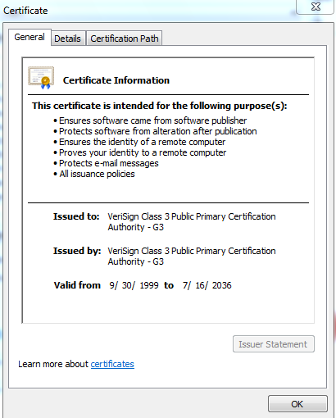
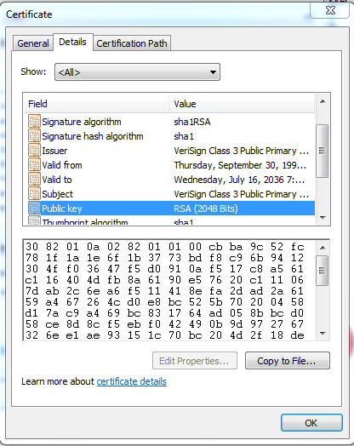
Certificates
X.509 v.4 standard
Provides authenticity of a server’s public key
Necessary to avoid MITM attacks with server’s using SSL or TLS
Digitally signed by Certificate Authority

Slide 40
PKI (Public Key Infrastructure)
Certificate Authority (CA)
Registration Authority (RA)
Certificate Repository
Certificate Revocation List

Slide 41
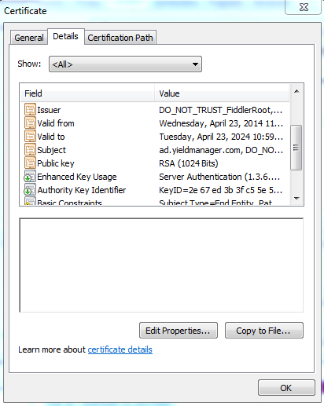
Certificate Contents

Slide 42
Certificate Revocation
CRL: CA publishes CRL. Client is responsible for downloading to see if a certificate has been revoked.
OCSP (Online Certificate Status Protocol) Streamlines the process of verifying whether or not a certificate has been revoked.

Slide 43
Encrypting Data in Transit
Protect Data as it traverses the network
Most protocols like IP, HTTP FTP are not inherently secure

Slide 44
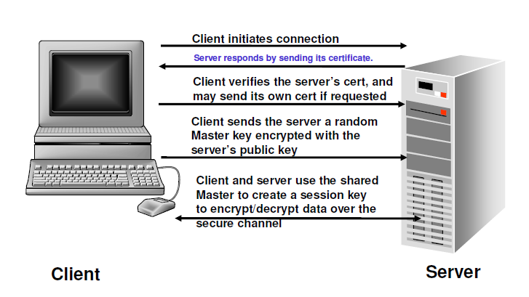
Encrypting Data in Transit: SSL/TLS

Slide 45
IPSEC
IPSec is an Encapsulation Framework that supports the security services of P.A.I.N
Tunnel Mode: Whole packet is encapsulated
Transport Mode: Only the payload is encapsulated
IPSec Header
IP Header
IP Payload
IP Trailer
IPSec Trailer
IPSec Payload
IP Header
IPSec Header
IP Payload
IPSec Trailer
IP Trailer
IPSec Payload

Slide 46
IPSec Sub-protocols
AH (Authentication Header) Provides integrity, authenticity, and non-repudiation through the use of an ICV (Integrity Check Value). The ICV is run on the entire packet (header, data, trailer) except for particular fields in the header that are dynamic (like TTL, etc). NO CONFIDENTIALITY
ESP (Encapsulating Security Payload) Provides authenticity and integrity through a MAC (no non-repudiation since a MAC is symmetric). The main service provided is ENCRYPTION.
IKE: Internet Key Exchange---No Security Services. Just management of secure connection
Oakley: Uses Diffie Hellman to agree upon a key
ISAKMP (Internet Security Association and Key Management Protocol) Manages Keys, Security Associations (SAs)and Security Parameters Index (SPI)
Notes:
IPSEC (Internet Protocol Security) Made up of several sub-protocols:
AH: Provides Authentication and Integrity. To provide integrity, AH uses an ICV (Integrity Check Value), which is essentially the same as a Message Authentication Code (provides system based, aka data origin authentication). This integrity check is performed on the whole packet, not just the data. This ensures that neither the data nor headers/trailers have been altered. This can cause problems with NAT.
ESP (Encapsulating Security Payload) provides encryption, authentication, and integrity checking on just the payload, so it is compatible with NAT.
IPSEC can operate in transport or tunnel mode. Transport mode is used for securing communications between end users on a network. Just the payload is encrypted.
Tunnel Mode is for securing WAN communication. Data, headers, trailers encrypted.
An SA (Security Association) functions in a manner similar to a socket. It tracks each secured session and contains information about that session and allows multiple IPSec connections to/from the same system. Each connection has two SA’s, one on each end. Computer A will have an SA to identify connection1 to Computer B—that SA might be called “1234”. Computer B will have an SA to identify it’s session with Computer A. That SA could be called “4321”. The point is, though the SA is known by different “names” on each computer, it’s really identifies the one connection.
There are two ways IPSEC manages keys. Each device wishing to communicate can be configured with a symmetric key, SA info, and other info. Or, the Internet Key Exchange (IKE) can be used. IKE is made up of two protocols, ISAKMP—Internet Security Association and Key Management Protocol-- and Oakley). How does this come into play?
If I want to establish a secure VPN connection between two routers, those routers will use a handshaking process to exchange security parameters like algorithms, key size, etc. This is information that you would not want a hacker to acces. Here’s where IKE comes in. First IKE is used to establish a secure channel between the routers. It uses Diffie Hellman to get a secure session key on each end. Second, that session key is used to encrypt VPN parameters. These parameters are stored as a part of the SA. Now, the data can be transmitted securely.

Slide 47
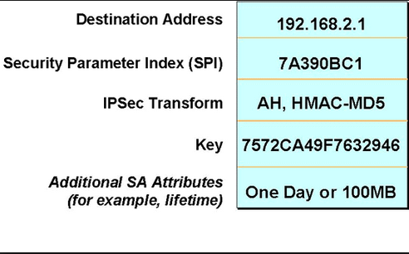
Security Associations and SPIs
Security Association
There will be at least two SAs for every secure connection

Slide 48

SSH (Secure Shell)
Secure alternative to unsecure remote administrative protocols
Telnet, FTP, R-utilitites (Rlogin, etc) transmit credentials in clear text
SSL sets up a secure tunnel

Slide 49
Implementation of Cryptography: Digital Envelopes in S/MIME
S/MIME (Secure Multipart Internet Mail Exchange) :
Standards based secure email by creating a digital envelope
Sender functions:
Calculate hash value on message
Encrypt message with session key
Encrypt hash value with private key
Encrypt session key with receiver’s public key
Receiver functions:
Decrypt session key with private key
Decrypt hash value with sender’s public key
Decrypt message
Calculate hash value and compare with one sent

Slide 50
Implementation of Cryptography: PGP (Pretty Good Privacy)
Proprietary mail standard from Phil Zimmerman
Free, but proprietary software must be installed
Uses Web of Trust
Passphrases instead of passwords
Learned keys are stored in a file called the key ring

Slide 51
Protecting Confidentiality of Data Rest
Data stored on local drives must be protected
Log off of workstations not in use
Use encryption within the operating system (ex: EFS in Windows environment)
Whole Drive Encryption: Protect Hard Drive in the event the disk is stolen
TPM
USB
Directory Services

Slide 52
Attacks on Cryptography
Ciphertext Only: Attacker has captured encrypted text on the network. Usually means all the attacker can do is brute force
Known Plain Text: The attacker has captured cipher text, but also knows what a portion of the message is in plain text (like an automatic signature)
Chosen Plaintext: Attacker can see the full text encrypted and decrypted. Usually the attacker has initiated the message
Chosen Ciphertext: An attacker can see whatever they want in plain or ciphertext. They have compromised a workstation. Sometimes called a lunchtime or midnight attack.

Slide 53
Attacks on Cryptography Continued
Meet in the Middle (Not to be confused with Man in the Middle). These attacks are targeted towards algorithms like 3DES where there are multiple key. An attacker tries to learn what each key does individually.

